Slide 1
Extending R Skills

Slide 2

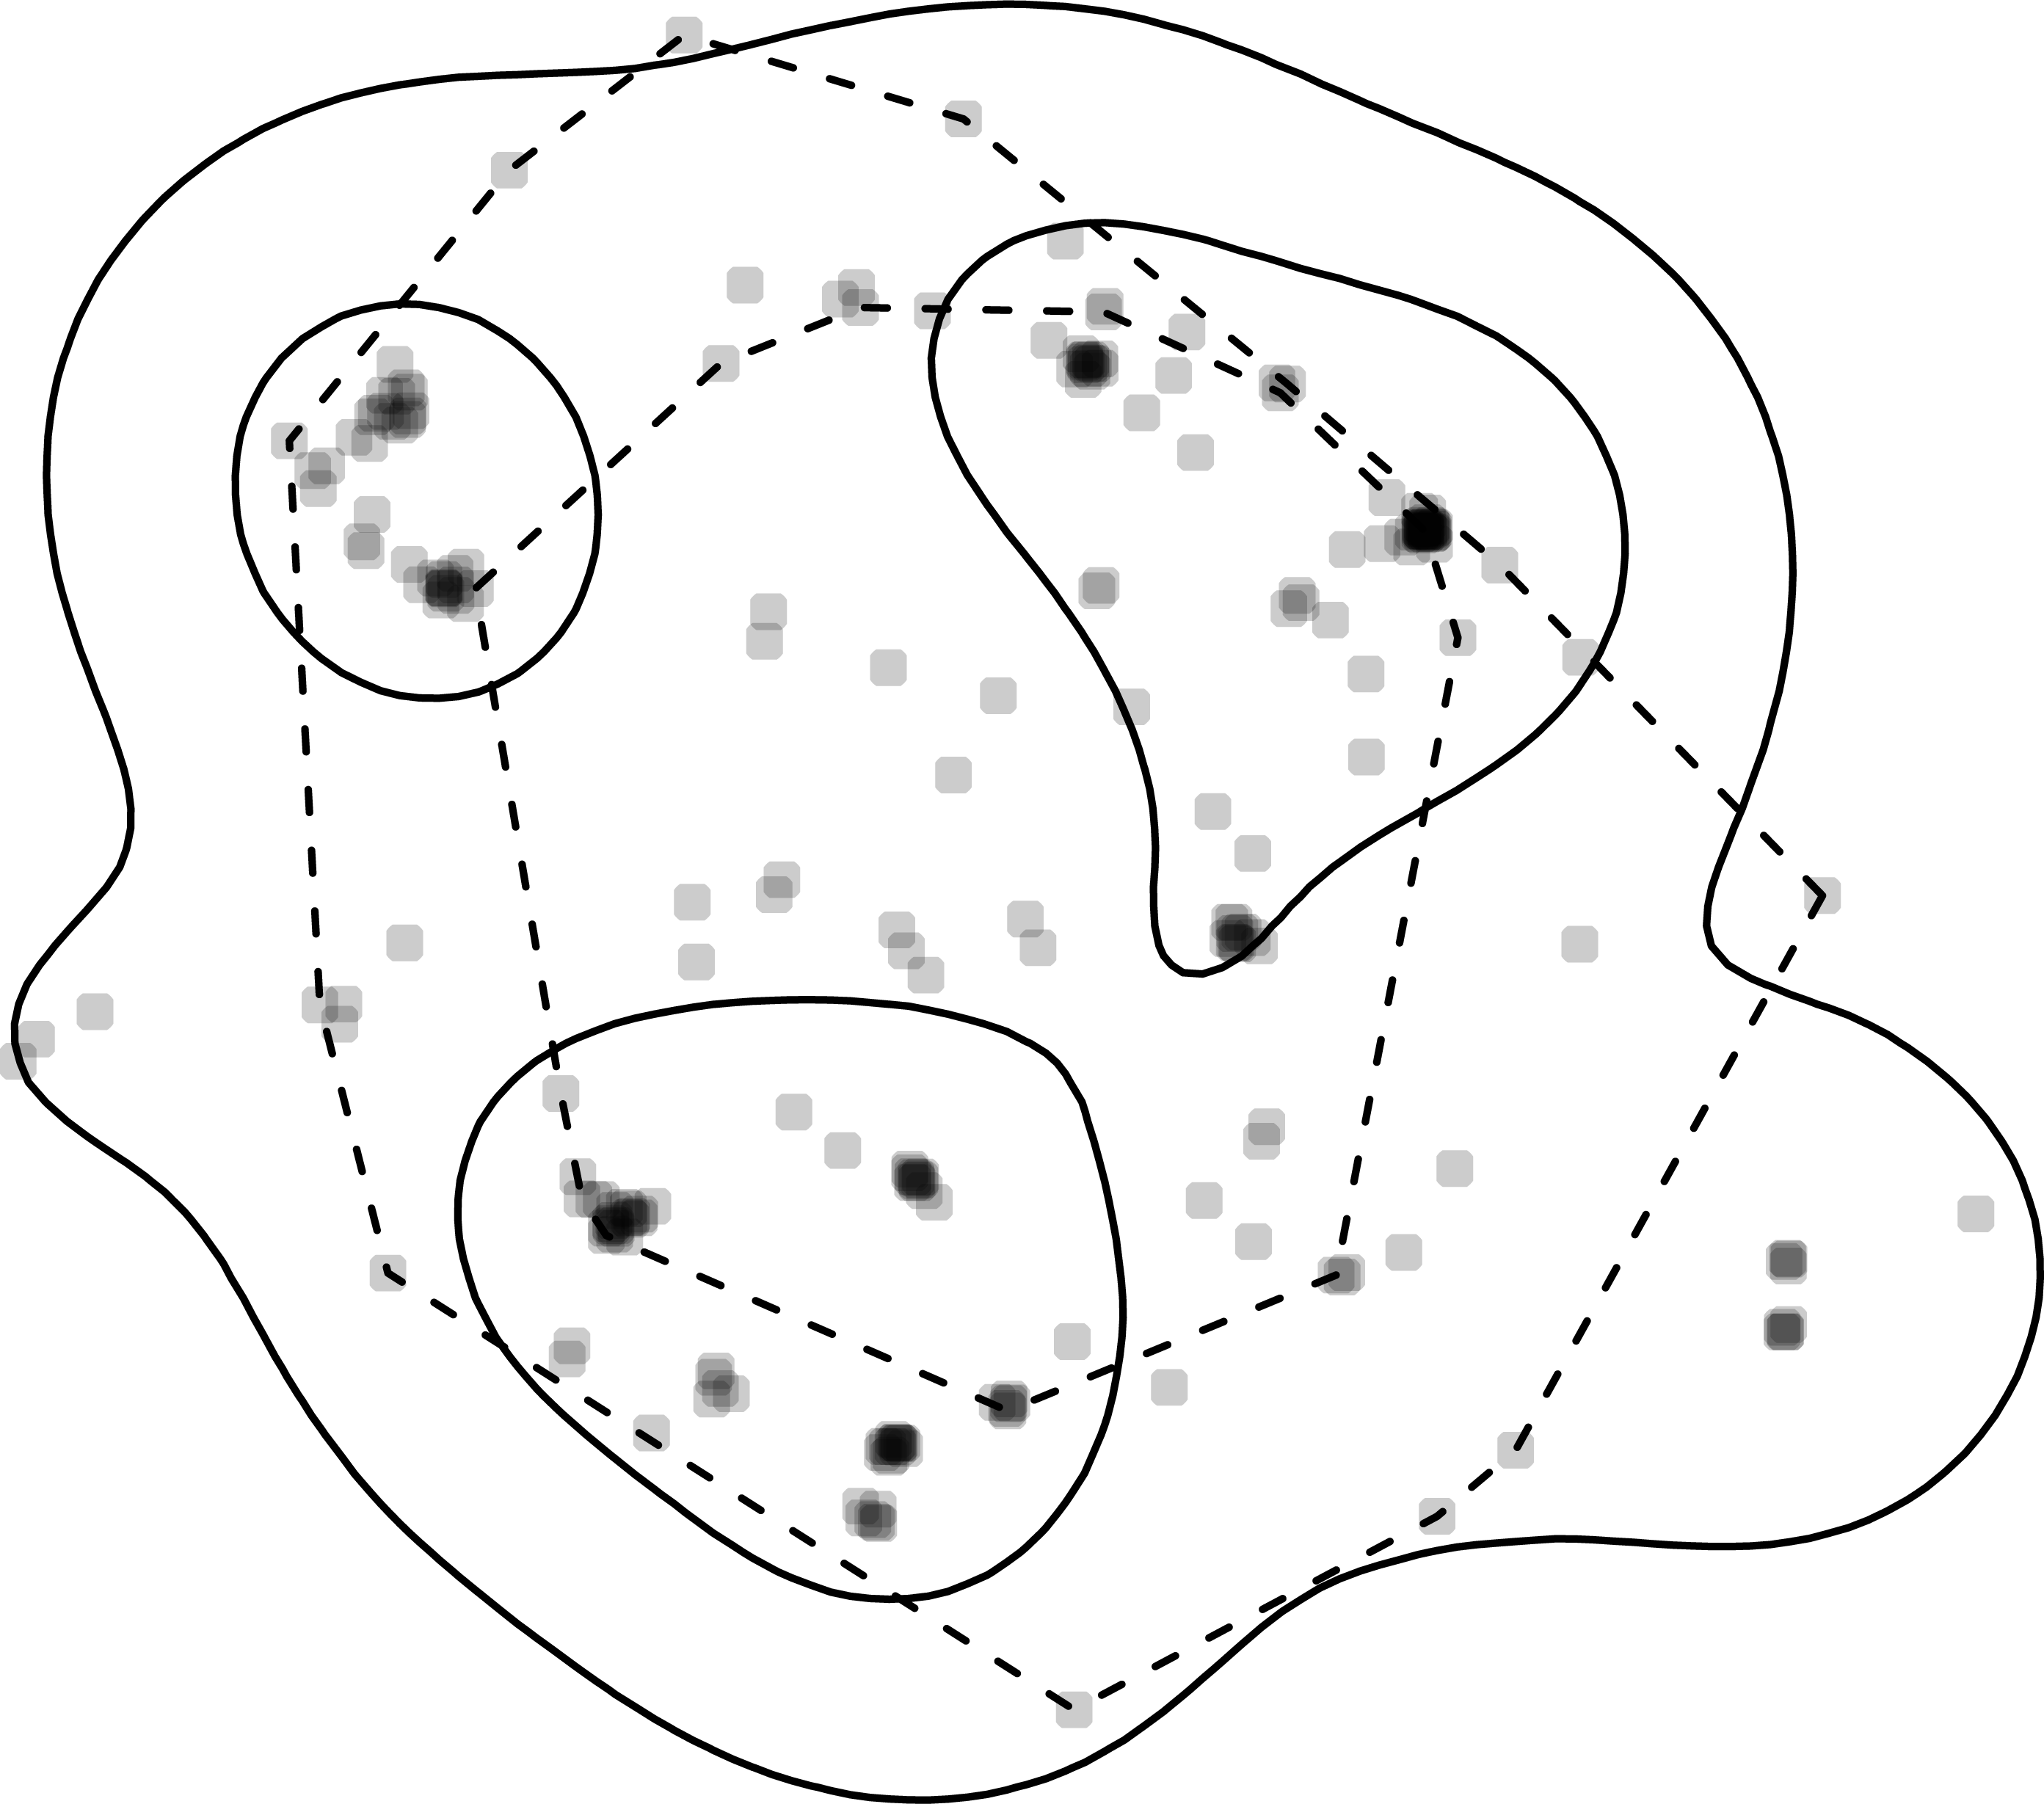



Working with spatial data
Simple features
Work with points, lines, and polygons
Cheatsheet: https://github.com/rstudio/cheatsheets/blob/main/sf.pdf
adehabitatHR: home range estimation
adehabitatLT: animal movement analysis
Work with raster data
R-ArcGIS bridge
Interactive mapping

Slide 3
Automation
Loops
apply() family of functions-avoid loops when you want to apply functions over vectors, lists, matrices (older)
‘purrr’ package works similar to apply() functions, but compatible with tidyverse (newer)

Slide 4
> my_list
$a[1] 1 2 3 4 5 $b[1] 6 7 8 9 10 $c[1] 11 12 13 14 15
For loop
> result
a b c
15 40 65
result <- vector("numeric", length(my_list))
names(result) <- names(my_list)
for (i in seq_along(my_list)) {
result[i] <- sum(my_list[[i]])
}
> result_list
$a
[1] 15
$b
[1] 40
$c
[1] 65
> result_vector
a b c
15 40 65
Apply
result_list <- lapply(my_list, sum)
result_vector <- sapply(my_list, sum)
> result_list
$a
[1] 15
$b
[1] 40
$c
[1] 65
> result_vector
a b c
15 40 65
Purrr
result_list <- map(my_list, sum)
result_vector <- map_dbl(my_list, sum)

Slide 5
Automation: task scheduling
taskscheduleR
# Schedule an R script to run daily at 8 AM
taskscheduler_create(
taskname = "daily_report",
rscript = "C:/path/to/my_script.R",
schedule = "DAILY",
starttime = "08:00"
)
# To check tasks
taskscheduler_ls()
# To delete a scheduled task
taskscheduler_delete("daily_report")
Point to script that needs to be tasked

Slide 6
Parallelization
When to use?
  Independent calculations over large datasets
    Extracting NDVI from hundreds of rasters
    Running thousands of simulations/resamples
    Machine learning models
Packages
  Foreach + doParallel (older, still works)
  future (newer, tidyverse) + furrr (newer, tidyverse)

Slide 7
Parallelization
foreach + doParallel
future + furr
# List all CSV files
files <- list.files("data/", "*.csv", full.names = TRUE)
# Create a cluster with 4 cores
cl <- makeCluster(4)
registerDoParallel(cl)
# Parallel read of CSV files
all_data <- foreach(f = files, .combine = 'list') %dopar% {
read.csv(f)
}
# Stop the cluster
stopCluster(cl)
# List all CSV files
files <- list.files("data/", "*.csv", full.names = TRUE)
# Set up parallel plan (4 cores)
plan(multisession, workers = 4)
# Parallel read of CSV files
all_data <- future_map(files, read.csv)

